Slide 1
King County House PRICE Prediction
Nidhi Vijayvargiya
DSS670 Predictive Analytics
Professor Ryan slay
16,October 2020

Slide 2
Objective:
It is generally accepted in the real estate market that property location, condition and age are significant factors that influence the property value. However, how much the price increases by changing the variables is not known to home buyers, and they usually rely on their experience to predict the price based on factors such as age, neighborhood etc.
The objective of this project is to use SAS Enterprise Miner and build a statistical model to determine which factors affect the property price and to analyze if location and age are the significant factors in determining the property value. The model will be used to predict the future real estate price based on the values of the variables that are strong predictors.

Slide 3
Why King County?
King is the most populous county in Washington, and the 13th-most-populous in the United States. The county seat is Seattle, which is the state's largest city.
Slower Price Growth Despite Higher Competition

Slide 4
Assumption
Significant factors
Price
Location
Age
Condition
How much Impact of significant factor ?

Slide 5
Data information and Extraction
Historical property value data was extracted from data set (kc_house_data.csv) got from Kaggle.
Train data collected is from the May 2014 to Mar 2015.
Score data collected is from April 2015 to May 2015.
Data details:
More than 20000 recordings, and 18 variables.
Predictors: Bedrooms, Bathrooms, Sqft_living, Sqft_lot, Floors,
Waterfront, View,Condition, Grade, Sqft_above, Sqft_basement,
Yr_built, Yr_renovated, Zipcode, Lat, Long.
The dependent variable is Price which is an interval variable.

Slide 6
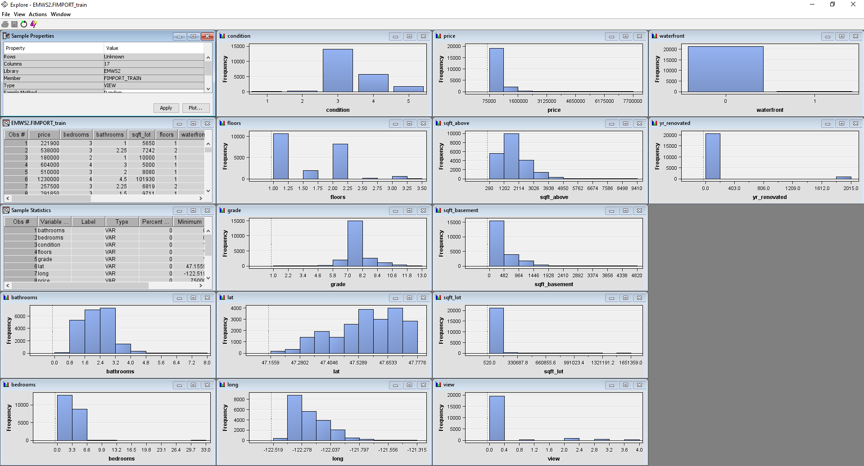
Data Issues
The histograms for distribution of variables show that almost all the variables are non normal.

Slide 7
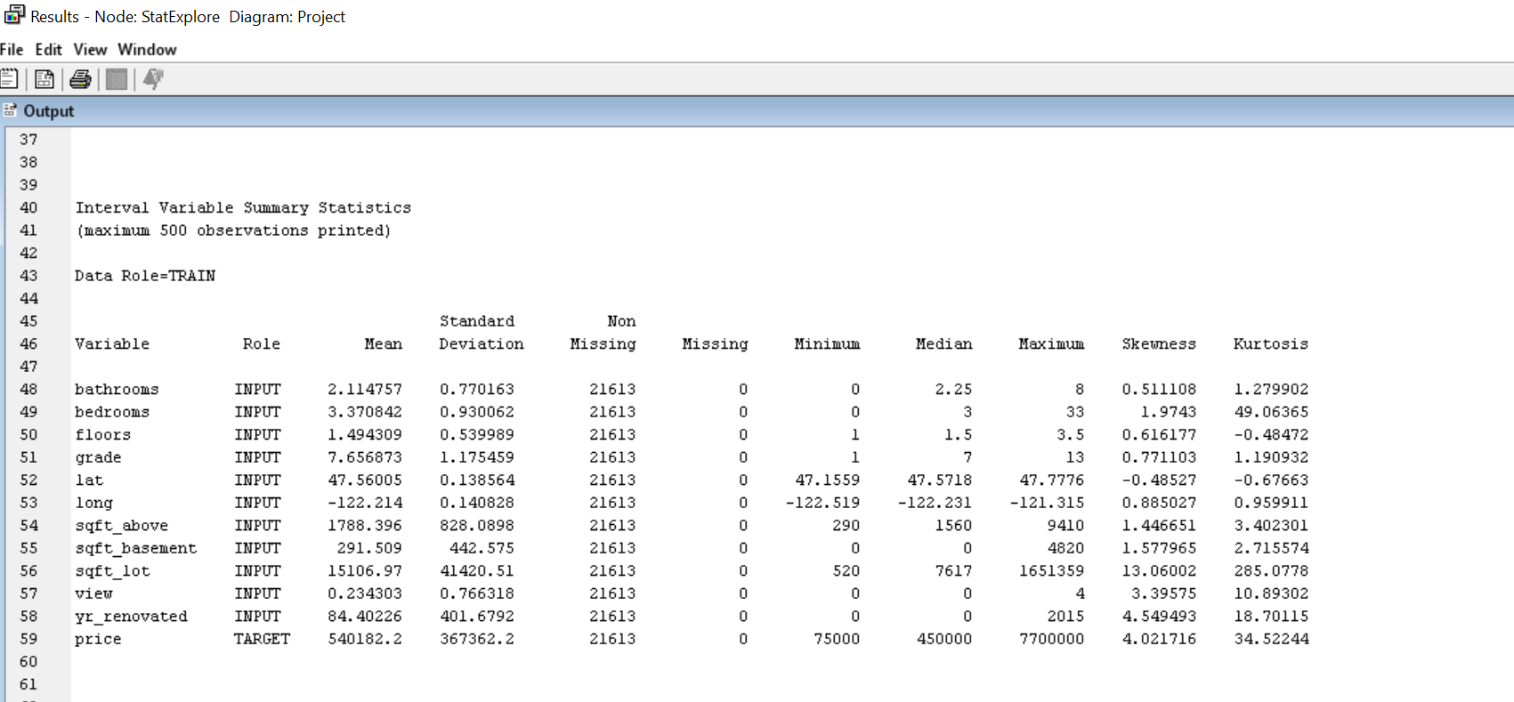
The skewness was confirmed using the StatExplore node.

Slide 8
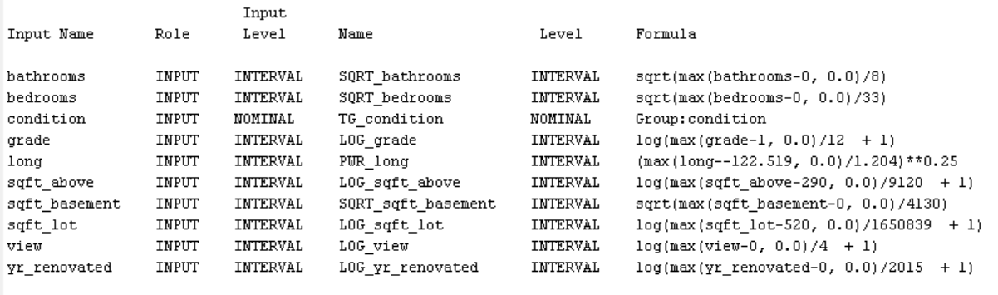
Data Exploratory
There is no missing values, so no imputation process needs to be handled.
The criterion to check whether a particular model is good or not is Average Square Error (ASE), because the target variable was an interval variable.

Slide 9
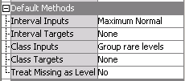
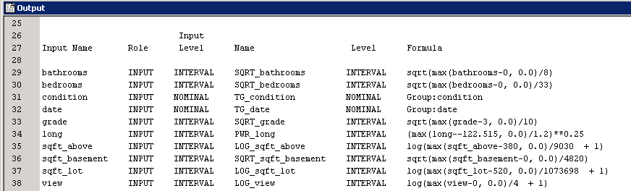
Transformation
Transformation node was added to diagram, which will make interval inputs maximum normal and group rare levels of class inputs
The SAS will only use the transformed variables in following models.

Slide 10
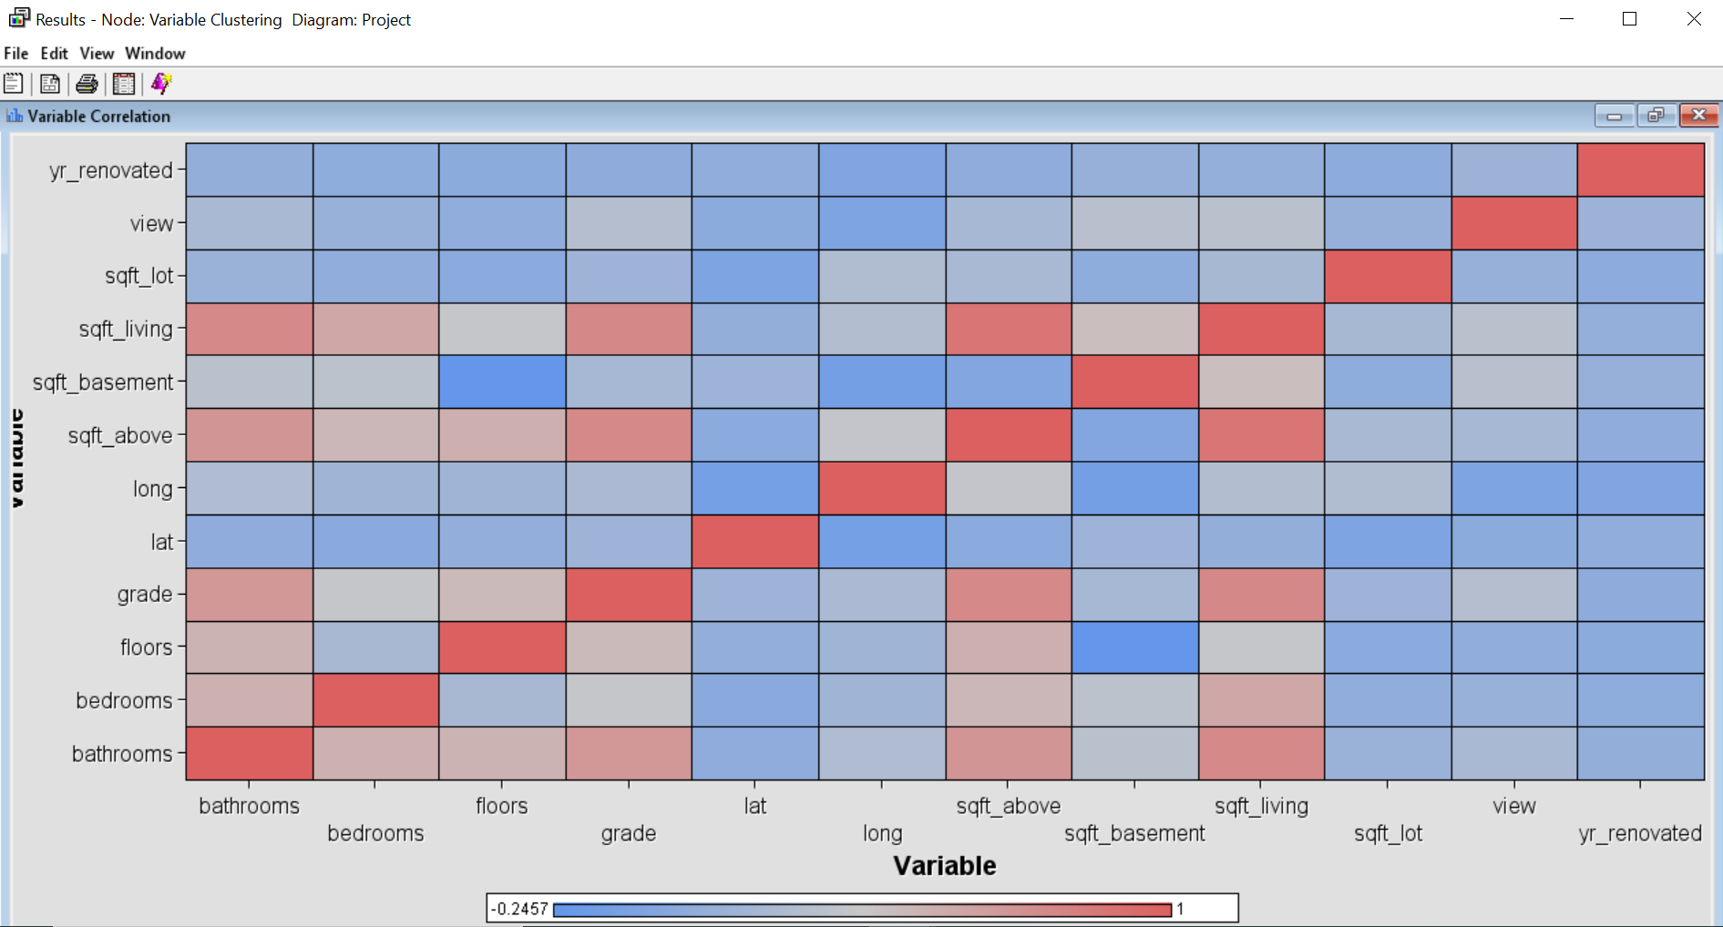
Check correlation between variables
From the correlation matrix, I can see that sqft_living and sqft_above are strongly positively related, which is because sqft_living is equal to sqft_above plus sqft_basement. So to avoid Multicollinearity reject sqft_living.
Notes:
Based on everything that we learned

Slide 11
Model Analysis
I have performed following models:
Neural network
Decision tree
Stepwise regression
( analysis explanation in the Appendix A)

Slide 12
Neural Network
Neural networks are a class of parametric models that can accommodate a wider variety of nonlinear relationships between a set of predictors and a target variable than can logistic regression. Building a neural network model involves two main phases. First, you must define the network configuration. You can think of this step as defining the structure of the model that you want to use. Then, you iteratively train the model.
A neural network model will be more complicated to explain to the management of your organization than a regression or a decision tree. However, you know that the management would prefer a stronger predictive model, even if it is more complicated.

Slide 13
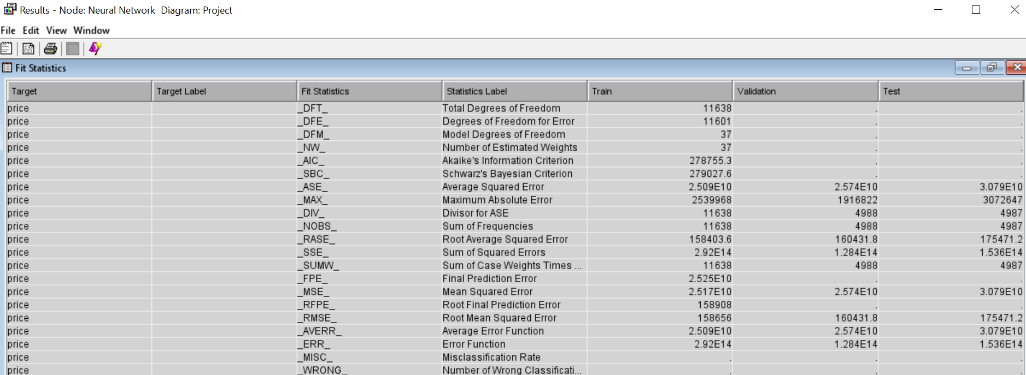
Neural Network

Slide 14
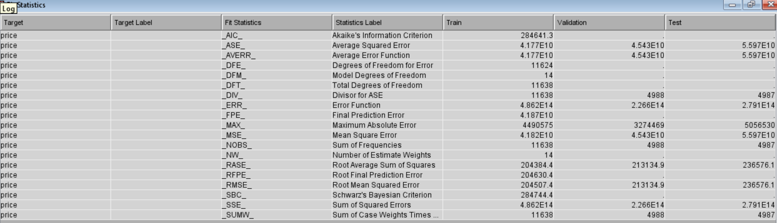
Stepwise Regression
Regression node estimates a linear equation. The score function is E(Y/X)=a’X, where Y is the target variable, X is a vector of inputs, and a is the vector of coefficients estimated by the Regression node.

Slide 15
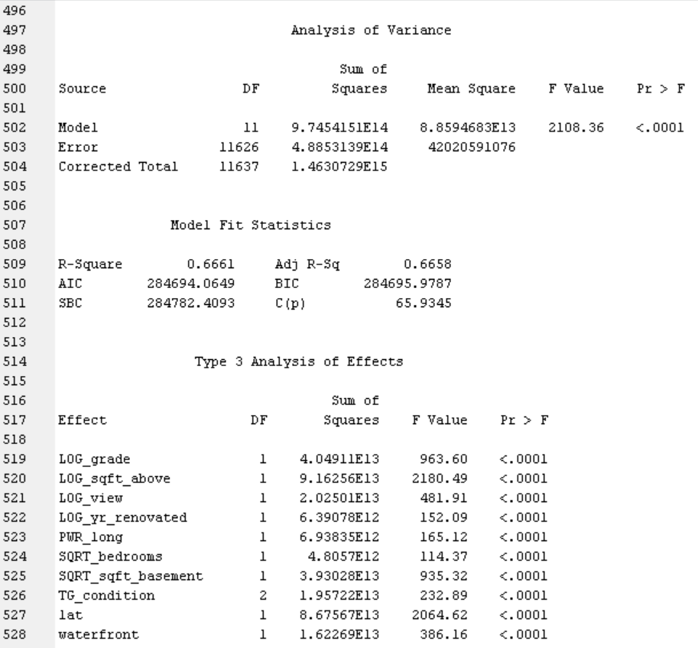
Stepwise Regression output

Slide 16
Decision Tree
Decision Tree: when the target variable is interval, decision tree node actually build a regression tree model. A decision tree represents a hierarchical segmentation of the data and is composed of root node and leaf nodes. Root node, the original segment, contains the entire data set. Then the entire data set is partitioned into several segments by filtering all observations through a series of simple rules. Each rule will give a value, and an observation is assigned to different segment based on that value. Through this process, a tree which is actually a hierarchy result is generated.
In this model, the optimum number of leaves is found to be 49. The grade, lat, long, sqft_above, waterfront are important predictors.

Slide 17
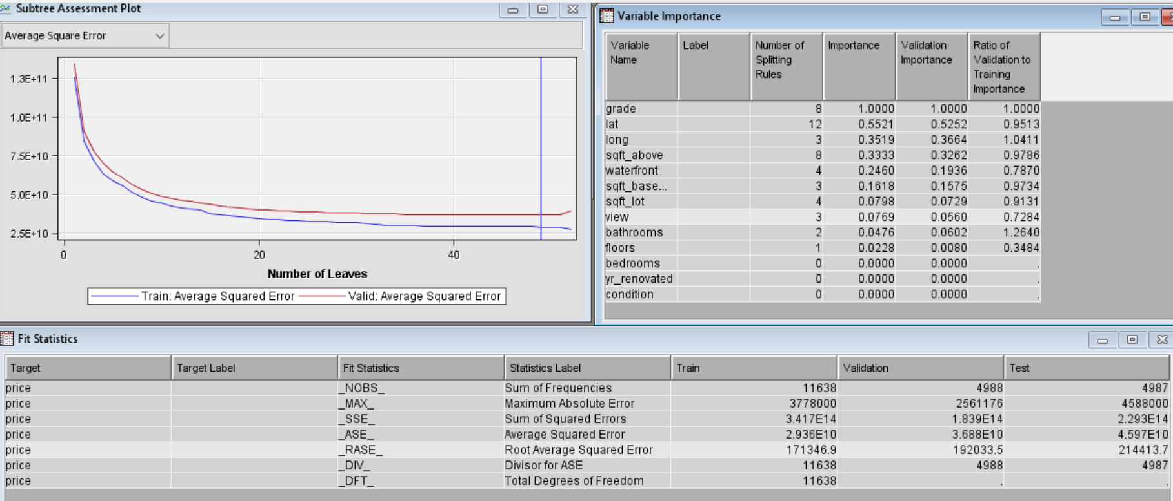
Decision Tree

Slide 18
Best Model –Neural Network
The Model Comparison Node compares all the models and selects the best model based on lowest Average Squared Error, misclassification error, and other measures.
The best model picked by Model Compare is the Neural Network. if models show very high average squared error, so are eliminated.
Score results:This node provides the comparison of the best model selected by the Model Comparison method like over here we have Neural network and train data output from Neural network is compared with the score data and bring the result.

Slide 19
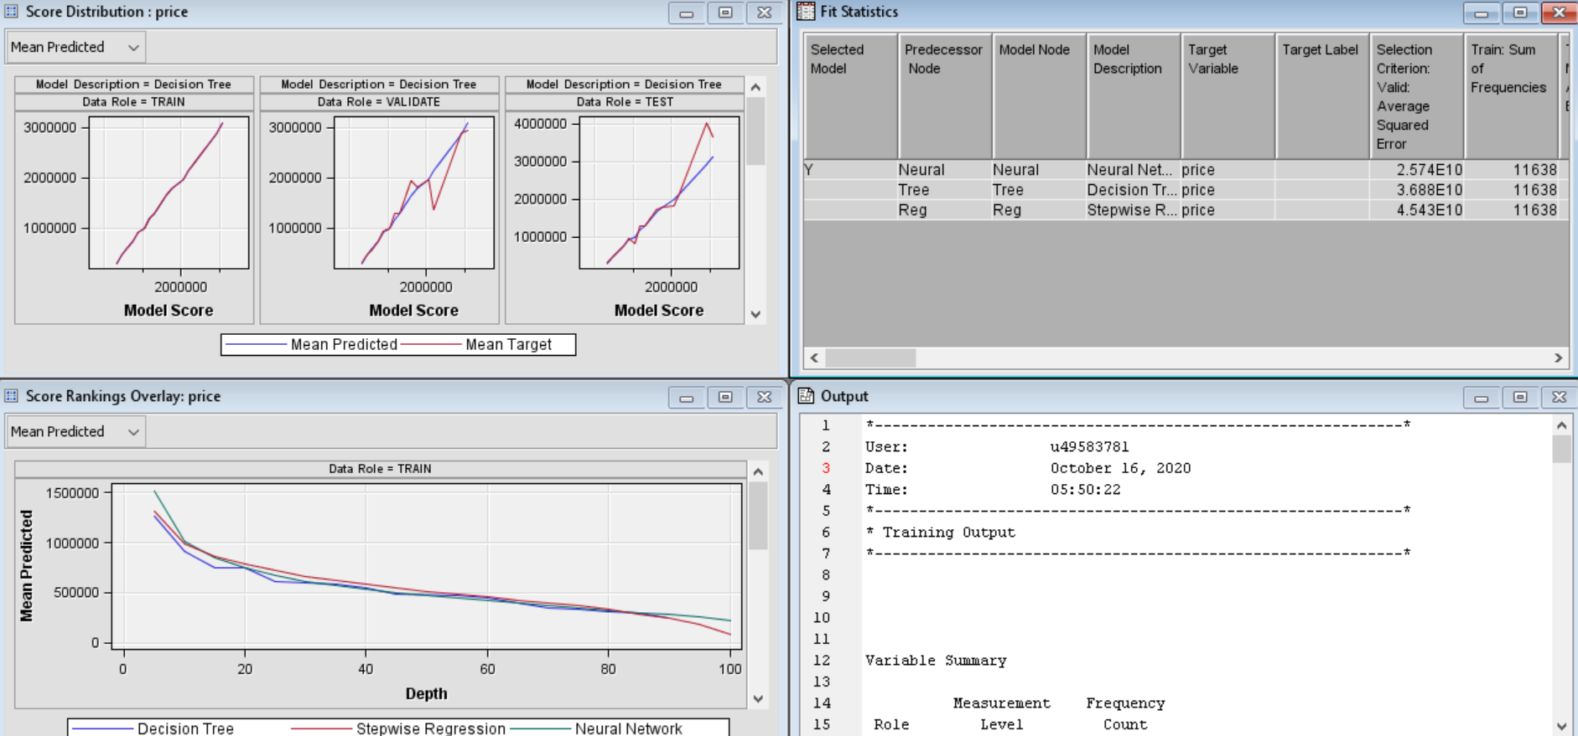
Comparison Result

Slide 20
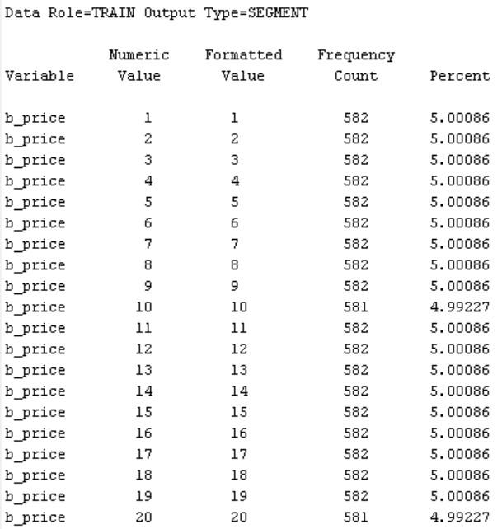
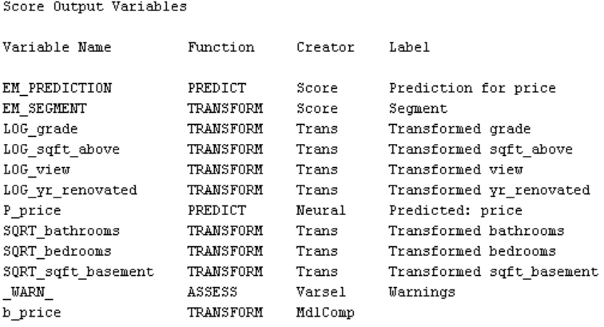
Score results

Slide 21
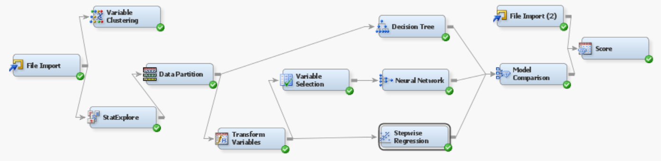
Appendix A Final Diagram

Slide 22
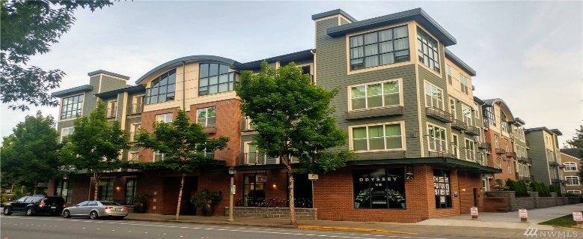
Conclusion
Location, Area, and Grade are more significant for price prediction
Higher Location, larger area, and higher grade lead to higher price
Age does not have big impact on price
Based on our analysis, we have observed that as per our assumption , location and area play big impact on the price.For higher location and larger area we have higher price. However one of our assumption failed that age of the property that is how old and new the house.Age does not have any significant impact on the price of property. Ever though the grade of the property is significant factor for property price.

Slide 23
Recommendations
Based on location, home buyer could prefer the property location as per their budget.
Sometimes higher the area would be preference, but budget is low, so homebuyer could look for lower location and get the property as per their area preference.
Home buyer could ask about the grade of property, so based on that they could ask for negotiation.
In the similar way, the property agent could work with the property to get the highest property value.

